Slide 1



Open Education Resources @ UMass Boston
A presentation to Faculty March 8th, 2022
https://www.umb.edu/elearning/open_education

Slide 2
Open Educational Resources
Agenda
Welcome – Provost Berger
The Taskforce / Team & Our Mission
What are OER & Why?
Benefits of OER
The Incentive Program
Plans for the coming months with a ‘Go Live’ date of Fall 2022
OER Resources

Slide 3
Welcome Message: Provost Berger

Slide 4
Open Education Resources – Team
Bringing together Faculty, Students, MASSPIRG, Library & IT with support from the Provost & Chancellors office.
Names | Names
Prof. Serra Acar (CEHD) | Ellen Foust – IT/eLearning & Instructional Design
Prof. Steve Ackerman (Honors) | Danny Rojas – Research Fellow (Provost’s Office)
Prof. Xiaolu Xu (CM) | Kush Patel – Chancellor’s Office
Joshua (Jake) Bates – USG | Open Position – Graduate Student
Lucas Hall – Library | Andrew Perumal – Associate Provost
Brianna Blastick – MASSPIRG | Apurva Mehta – IT
AlexieLudgie Goin – MASSPIRG
Visit: OPEN.UMB.EDU → OER Adoption Program -- Email: open@umb.edu
The team is happy to help and looks forward to working with you!

Slide 5
Open Education Resources – Our Mission
To build a program, using incentives, that promotes textbook affordability for students by supporting and facilitating the adoption of open, low-cost, high-quality materials, called Open Educational Resources, or OER.

Slide 6

“…higher education shall be equally accessible to all”
Notes:
We are talking about an issue that is much broader than just textbooks. This is a social justice and an Equity issue.
When you read this, you might think of people around the world who don’t have physical access to higher education. But we’re also talking about here - in the US, where there are people who do not have equal access to higher education
Technically, the US never ratified this but was central to its creation and wording. ----- the fuller quote is, “Technical and professional education shall be made generally available and higher education shall be equally accessible to all on the basis of merit.”
Here is the link http://www.theadvocatesforhumanrights.org/human_rights_and_the_united_states
Suggestion: Contextualize this slide in the presentation as a reflection of how you feel about education and why you work with the OTN.
Consider asking attendees what "merit" might have meant to the drafters in 1948 and how might we think differently of it now.

Slide 7

What Is Open Education Resource (OER)
“OER are teaching, learning, and research materials in any medium – digital or otherwise - that reside in the public domain or have been released under an intellectual property license that permits their free use and re-purposing by others. Open educational resources include full courses, course materials, modules, textbooks, streaming videos, tests, software, and any other tools, materials, or techniques used to support access to knowledge.”
The William and Flora Hewlett Foundation

Slide 8
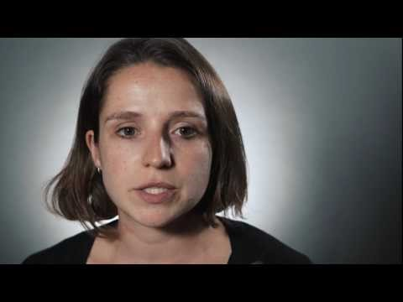
Open Education Resources - What is OER
O → Open – Openly Accessible / public domain
E → Educational – Teaching, Learning, and Research resources
R → Resources – Content to support access to knowledge.
Think Five R’s
  Reuse - use freely for own purpose
  Redistribute - share with others
  Revise - adapt, modify, change
  Remix - combine / transform
  Retain: download and save
What are OER - A 90 second video by Lumen Learning

Slide 9
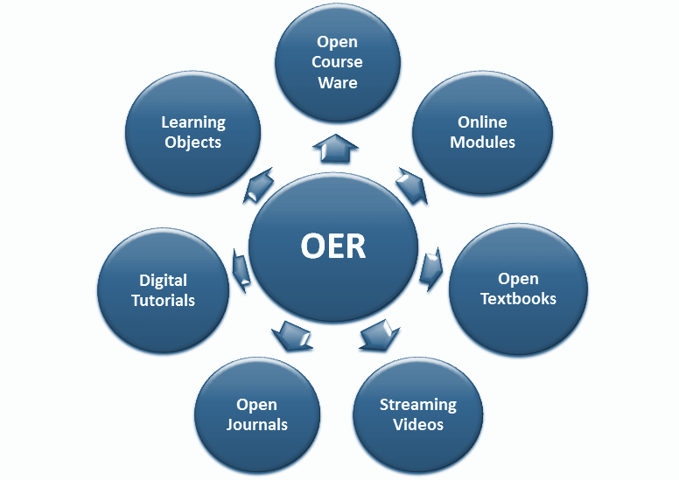
Open Education Resources – Types of OERs

Slide 10
Why OER

Slide 11
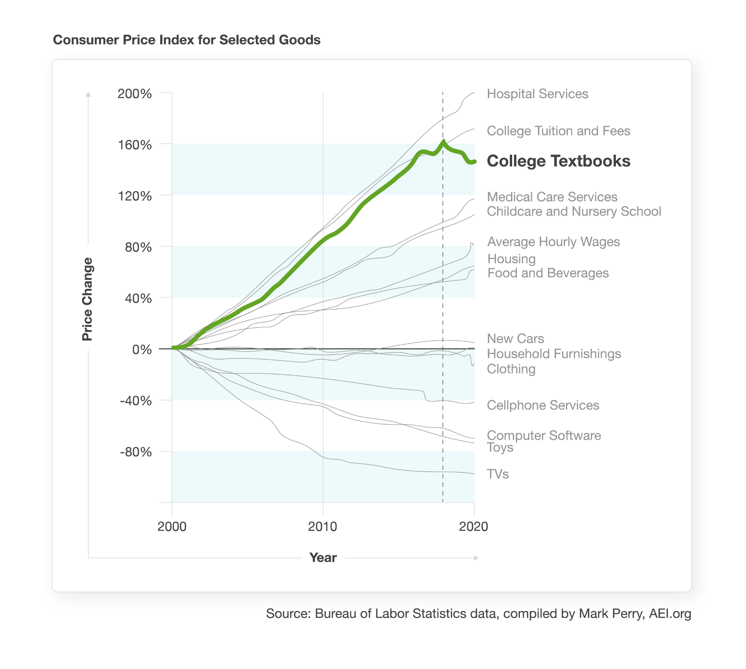
Open Education Resources – Why OER

Slide 12
Open Education Resources – Why OER
What are the biggest cost challenges facing a college student?
Tuition | 61.65%
Course materials | 39.56%
Housing costs | 38.10%
Food expenses | 31.02%
Living expenses | 30.18%
Transportation | 18.49%
Technology | 15.45%
Additional school supplies | 7.66%
Daycare | 3.04%
Other | 2.16%

Slide 13
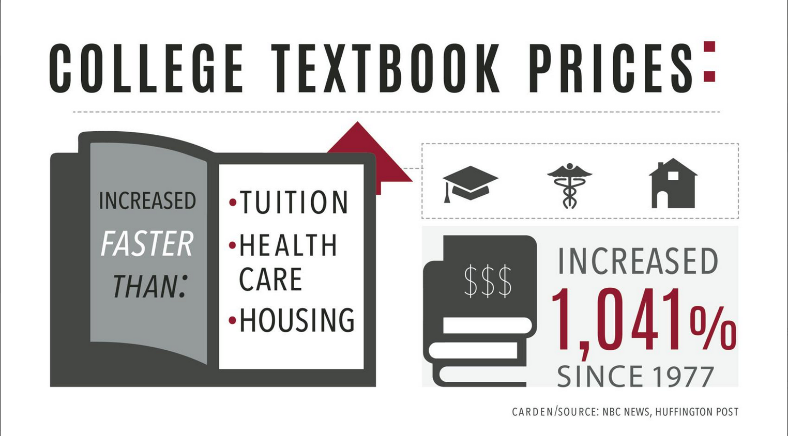
http://www.dailytoreador.com/news/library-student-government-hoping-for-solution-to-expensive-book-prices/article_490647b8-36d1-11e8-a857-9325559e8187.html
https://www.nbcnews.com/feature/freshman-year/college-textbook-prices-have-risen-812-percent-1978-n399926
Notes:
Despite growing online markets for discounted books, the average cost of college textbooks has risen four times faster than the rate of inflation over the past 10 years (- an astonishing 1,040% since 1977 -) that is not a typo
The result is 65 percent of students have skipped buying required texts at some point in their college career because of a lack of affordability.

Slide 14
Open Education Resources – Why OER
Coping with the Cost
Purchase an older edition of the textbook
Delay purchasing the textbook
Never purchase the textbook
Share the textbook with other students
Download textbooks from the internet
Notes:
So - How do students cope with the high costs and the academic impact of these decisions.
Some notes:
Delay purchasing: (This has become the rule, not the exception.) Students need to make a value judgements, and they most likely have had an experience where they purchased an expensive textbook that was never or rarely used. Students learn from that, and change their behavior. There is Research that indicates freshmen will buy their books more than sophomores, juniors, and seniors. When they learn - buying the textbook wasn’t necessary, they learn to wait.
And those on financial aid may not get their aid until three weeks into the term - so they are forced to wait
Never purchase: About ⅔ of students say that, at some time in their academic career, they didn’t purchase a required textbook, and about ⅓ admit they do this each term.
downloading textbook, is a legal risk with copyright violation - but many are doing it. The top four items aren’t legal risks, but all are academic risks.
Ask yourself, can a student succeed in my class without the required text, or workbook or other ancillary materials

Slide 15
Open Education Resources – Why OER
Benefits
Reduce Cost of Education / textbook costs
Support student success & retention
Equal Access – All students have access to the textbook on day 1
Accessibility – as it is born digital
A platform for faculty to create/edit/revise OER
Challenges
Quality – OER repositories include peer review and rating systems
Time – adopting OER will take time
Lack of ancillary content – however this is changing

Slide 16


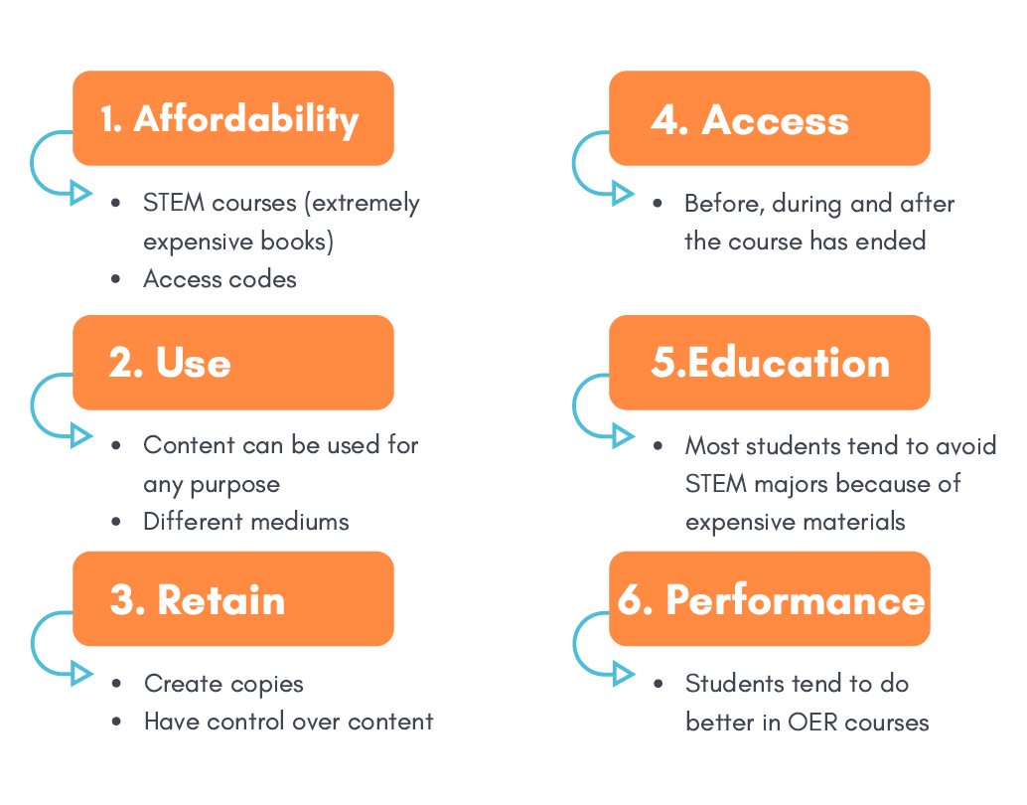
Student Perspective
“
Students are under a lot of stress these days and it’s unacceptable for anyone to have to drop a course because they can’t afford educational materials, or to skip meals so that they can buy books. Our voices will continue to champion the need for equity and affordable options.
“
Jorgo Gushi - chair of the student Advisory Council - QCC
Notes:
Jorgo the chair of the student Advisory Council - QCC
Jorgo Gushi

Slide 17
The Incentive Program

Slide 18
Open Education Resources – The Incentive Program
Adopt
Large Intro Course | More than 100 Students | $1,500
Multi-Section | Two or more courses | $1,500
Regular Intro Course |  | $1,000
Adapt
Large Intro Course | More than 100 Students | $3,000
Multi-Section | Two or more courses | $4,000
Regular Course |  | $2,000
Create
Large Intro Course | More than 100 Students | $4,000
Multi-Section | Two or more courses | $5,000
Regular Course |  | $3,000

Slide 19
Next Steps

Slide 20
Open Education Resources – Next Steps
Complete a survey - asking faculty to share if they are using OER/Low Cost (<$40)
https://umassboston.co1.qualtrics.com/jfe/form/SV_eVu7f6M2QNSIrbM
Work with the Registrar’s office to Mark/Flag courses in WISER that use OER/Low Cost material. Allow students to select courses that help reduce the cost of education.
Implement the Incentive program – where faculty can apply to adopt/adapt/create OER material.
Work with Faculty who have been awarded the incentive
Recognize faculty that have adopted OER in their course

Slide 21
Open Education Resources – Resources
Find OER - https://www.umb.edu/elearning/open_education/find_oer
Library Databases/Resources & LinkedIn Learning
State of Massachusetts OER Initiative
Metafinder @ George Mason
OER Commons
Merlot
OpenStax
OTN (Open Textbook Network) – Univ. of Minnesota
Lumen Learning – Low-cost open courseware -$25 per student

Slide 22
Open Education Resources – Questions
Visit: OPEN.UMB.EDU → OER Adoption Program
Email: open@umb.edu
The team is happy to help and look forward to working with you!

